Slide 1
Introduction to
Generative Adversarial Networks
(GANs)
Nguyen Tuan Duong
Nguyen Phuoc Tat Dat
(2017/9/9)

Slide 2
Agenda
Generative Modeling
Idea of GAN
Training GAN
Distribution matching
Example
Variants
Applications of Generative Models

Slide 3
Generative Modeling

Slide 4
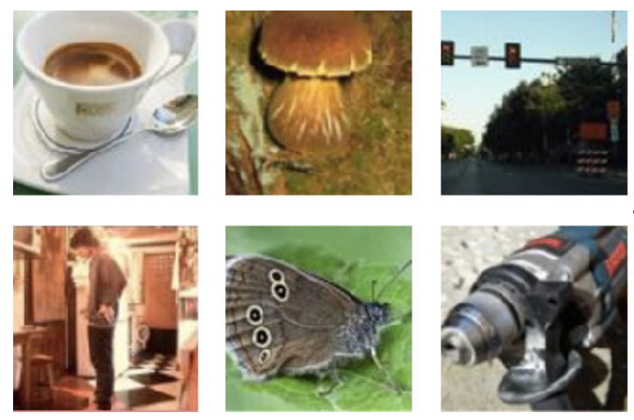
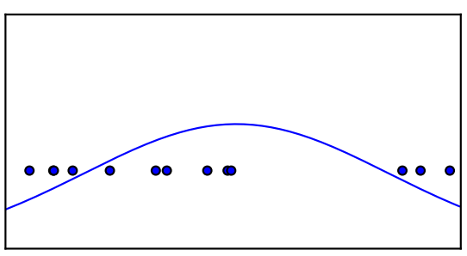
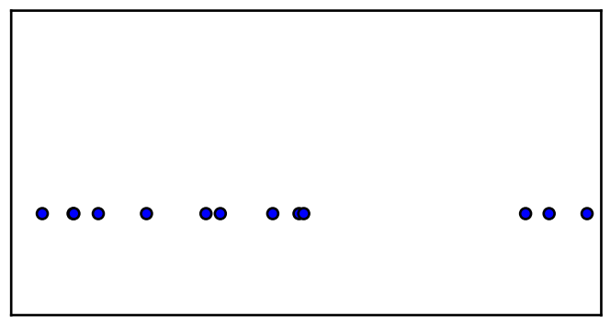
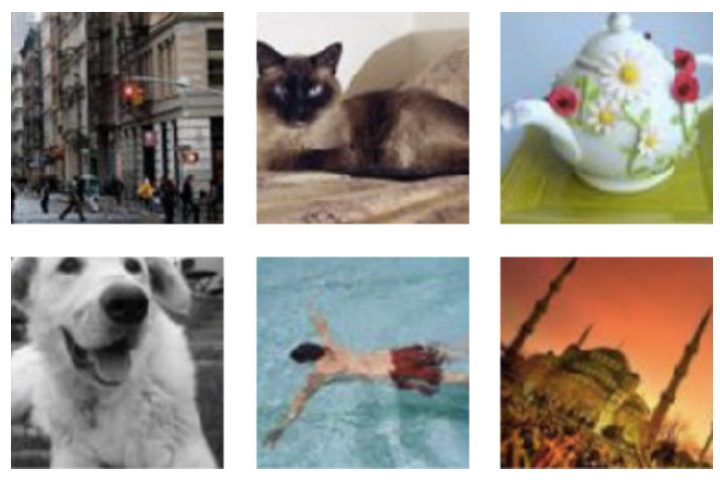
Generative Modeling
Density estimation
(Explicit or implicit)
pmodel
Training samples
pdata
(Goodfellow 2016)
Model samples

Slide 5
The idea of GAN

Slide 6
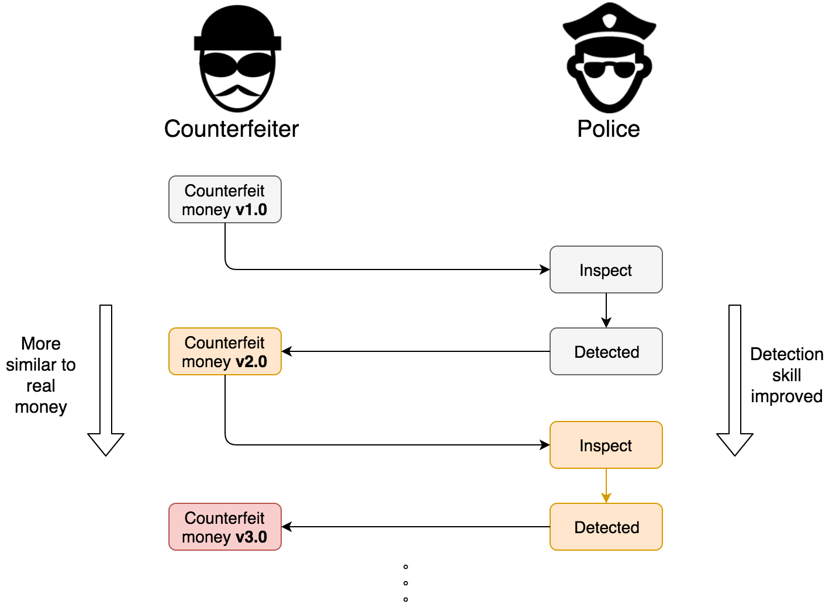
The idea of GAN
Generator
Discriminator

Slide 7
Training GAN

Slide 8
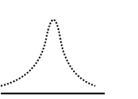
Framework
Distinguish real & fake samples:
* 0: Fake
* 1: Real
Try to fool the Discriminator
by generating fake samples
Real samples
Discriminator
Real/Fake
label
Generator
Fake samples
z: noise
variable
Neural
Network
Generative Adversarial Networks

Slide 9
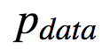
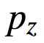
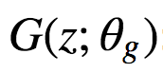
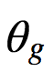
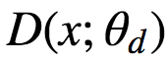
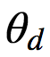
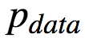
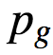
Notation
Distribution of training data
Distribution of the noise variable z
Differentiable function with parameters , which receives z
as input, and outputs an fake image.
Function with parameters , which receives image x as input,
and outputs a probability that x came from
Generator's distribution
m
Number of training samples

Slide 10
Goal
Real samples
Discriminator
Real/Fake
label
x
Generator
Fake samples
z: noise
variable
0: Fake
1: Real
Neural
Network
Ultimate goal:
Train a good generator G which can generate an item x such that it seems to come from real samples.

Slide 11
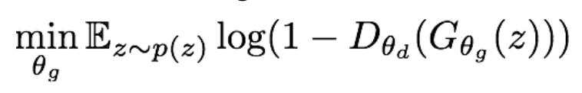

Goal
Real samples
Discriminator
Real/Fake
label
x
Generator
Fake samples
z: noise
variable
0: Fake
1: Real
Neural
Network
Minimize the loss function of G
Maximize the loss function of the D

Slide 12

Minimax game
The training process is playing the minimax game between G and D:
(Goodfellow 2014)

Slide 13
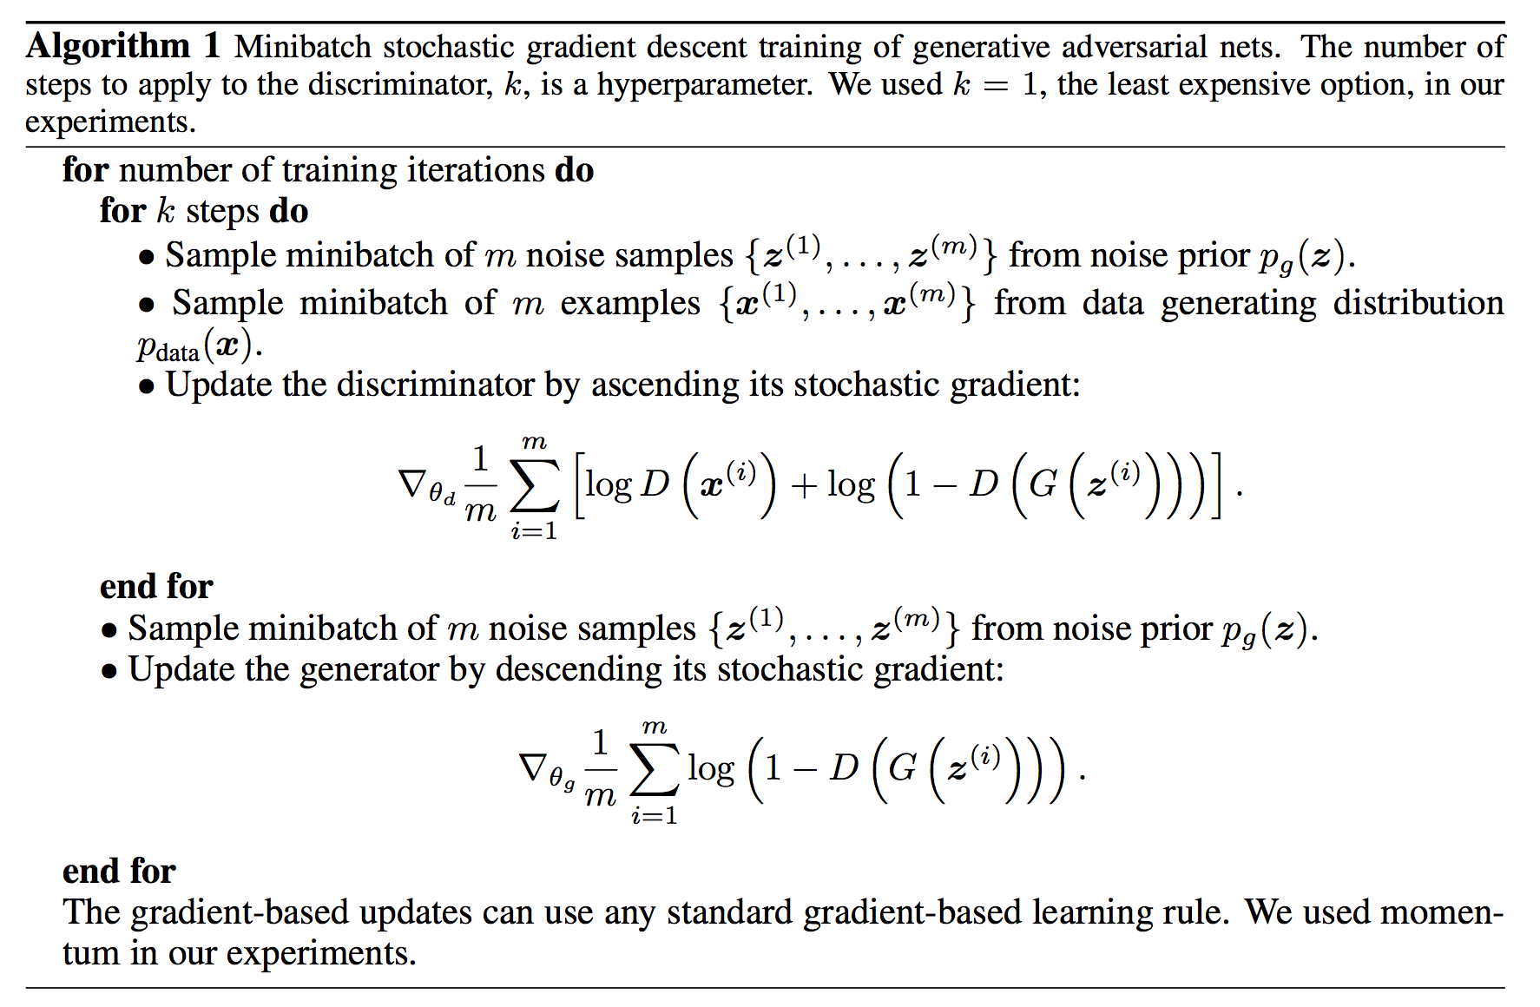
Algorithm

Slide 14
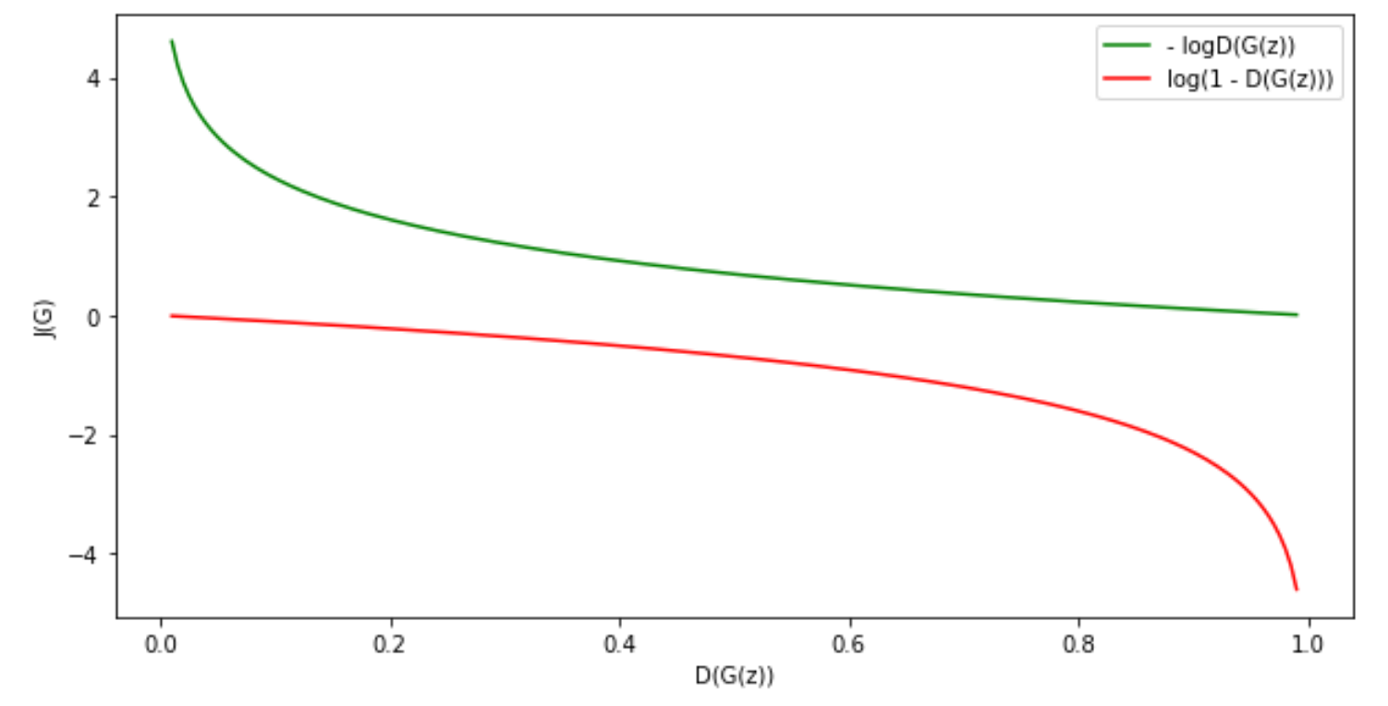
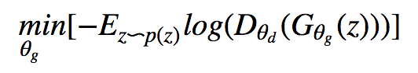
Gradient saturation in minimax game
The inner loop (with k) will optimize D. We hope this step makes D(G(z)) near to 0
In minimax game, the loss function of G will be optimized with the target log(1-D(G(z))), which gives low gradient when D(G(z)) near to 0
One trick to solve the low gradient problem is to change the target when optimizing the loss function of G:

Slide 15
Improved version
Minimize the loss function of G
Maximize the loss function of the D
Minimize the loss function of G
Improved version
Maximize the loss function of the D
(Goodfellow 2016)

Slide 16
Distribution matching
(Jupyter notebook)

Slide 17
Example Generating handwritten digits

Slide 18


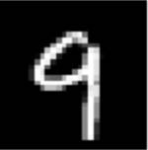
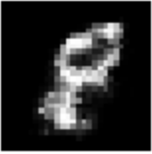
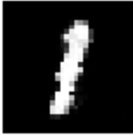




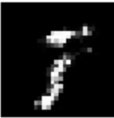

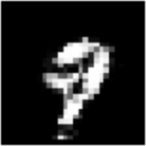

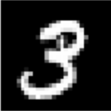
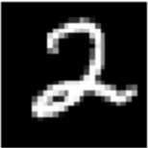
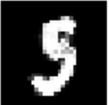
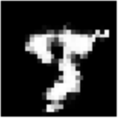
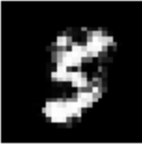
Example
Generate hand-writing digit trained on MNIST dataset
Train the models on MNIST dataset
Dataset of hand-written digit greyscale images
60,000 training and 10,000 testing images of size 28x28
Real hand-writing digits
(real images)
Generated hand-writing digits
(fake images)

Slide 19
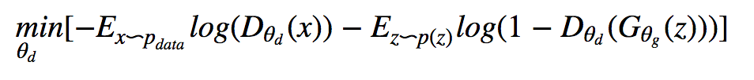
Change the loss function optimization for practice
Minimize the loss function of G
Improved version
Maximize the loss function of the D
Minimize the loss function of G
In practice
Minimize the loss function of the D
(Goodfellow 2016)

Slide 20
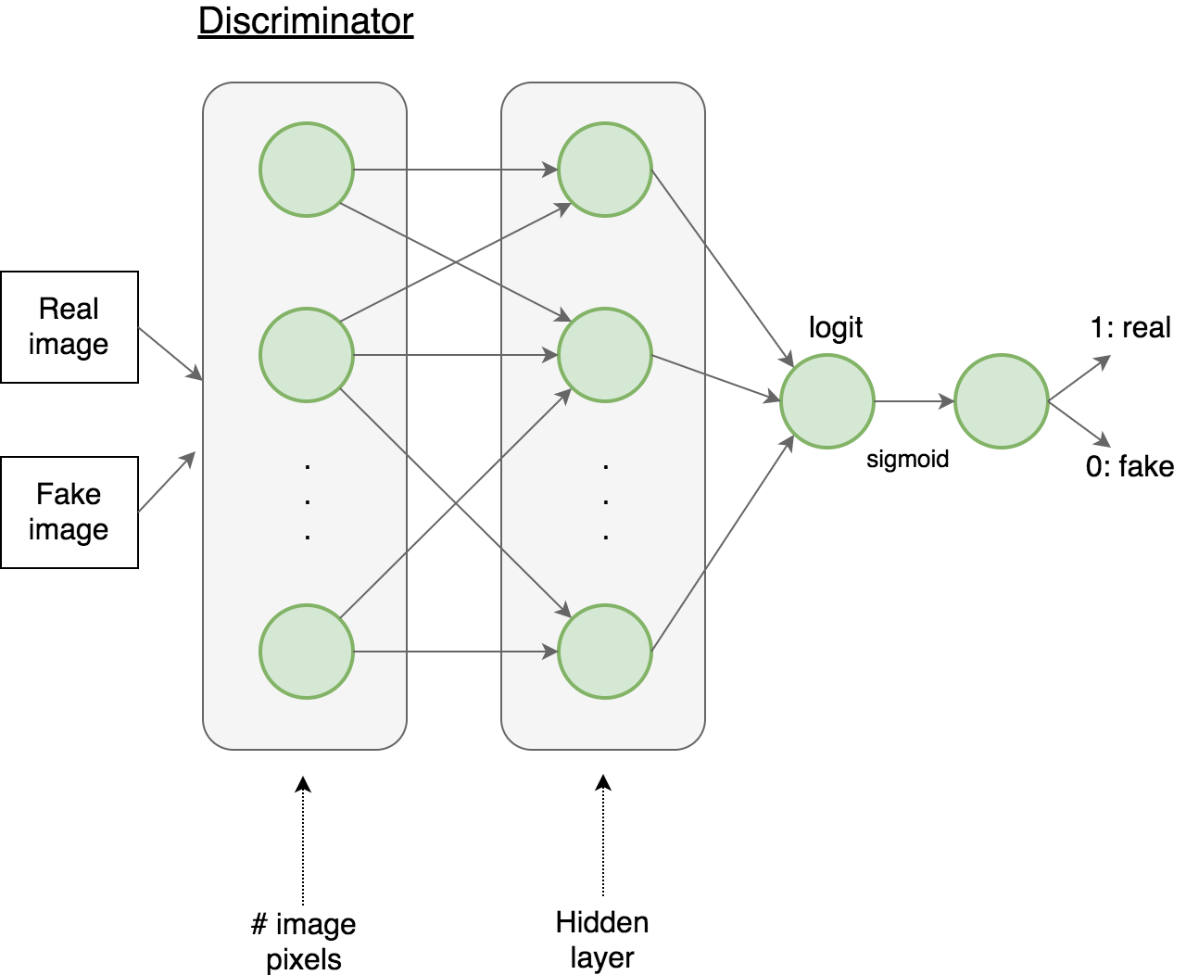
Network Architecture - Discriminator
(784)
(128)

Slide 21
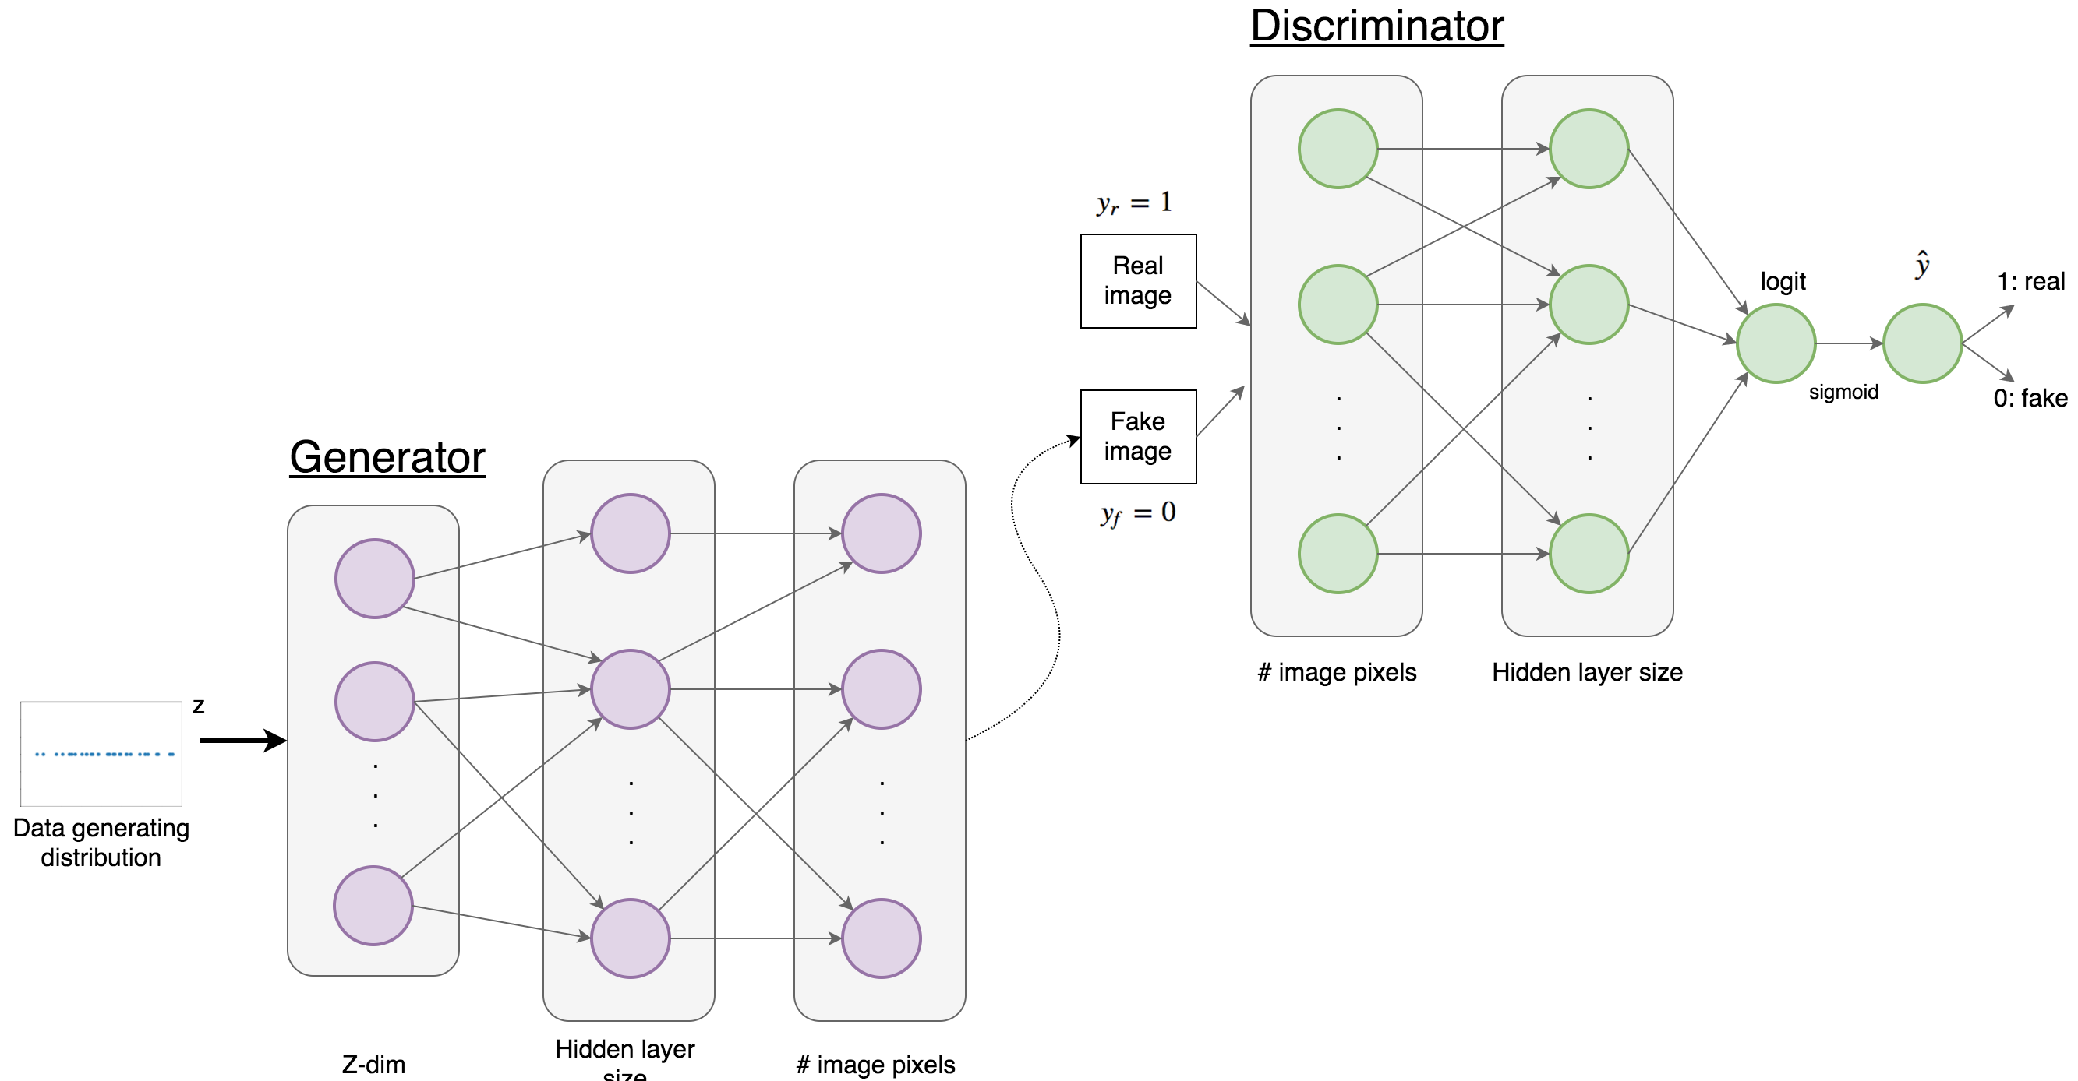
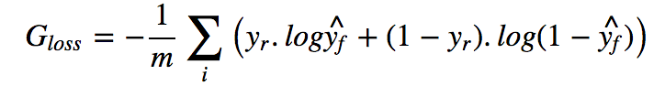
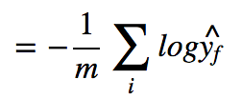
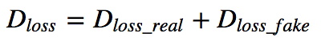
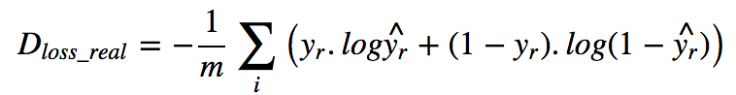
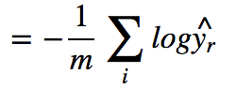
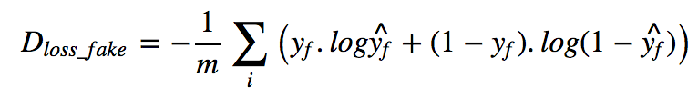
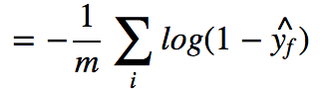
Network Architecture
Cross-Entropy loss
btw predicted FAKE label & REAL label to fool D
Cross-Entropy loss

Slide 22
Demo
(Jupyter notebook)

Slide 23
Variants

Slide 24
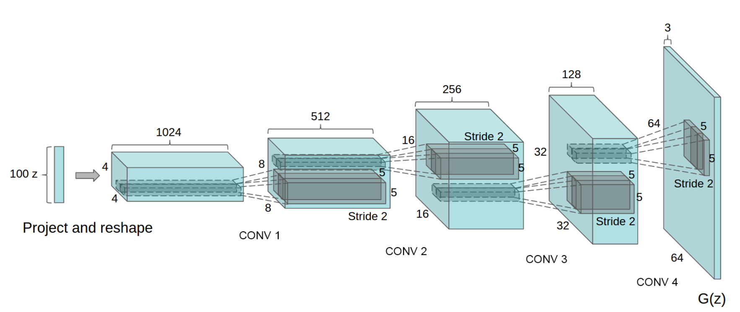
DCGAN
・DCGAN architecture for the generator used for Large-scale Scene Understanding (LSUN)
・From 100-dim random space to 64x64 images
(Radford et al, ICLR 2016)

Slide 25
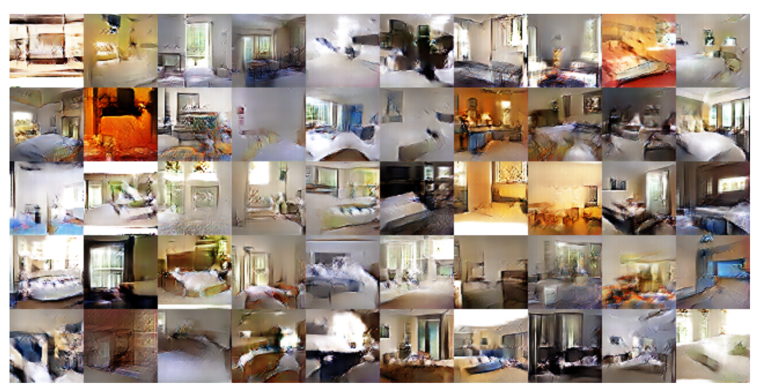
DCGAN
・Generated samples after training on LSUN dataset
(Radford et al, ICLR 2016)

Slide 26
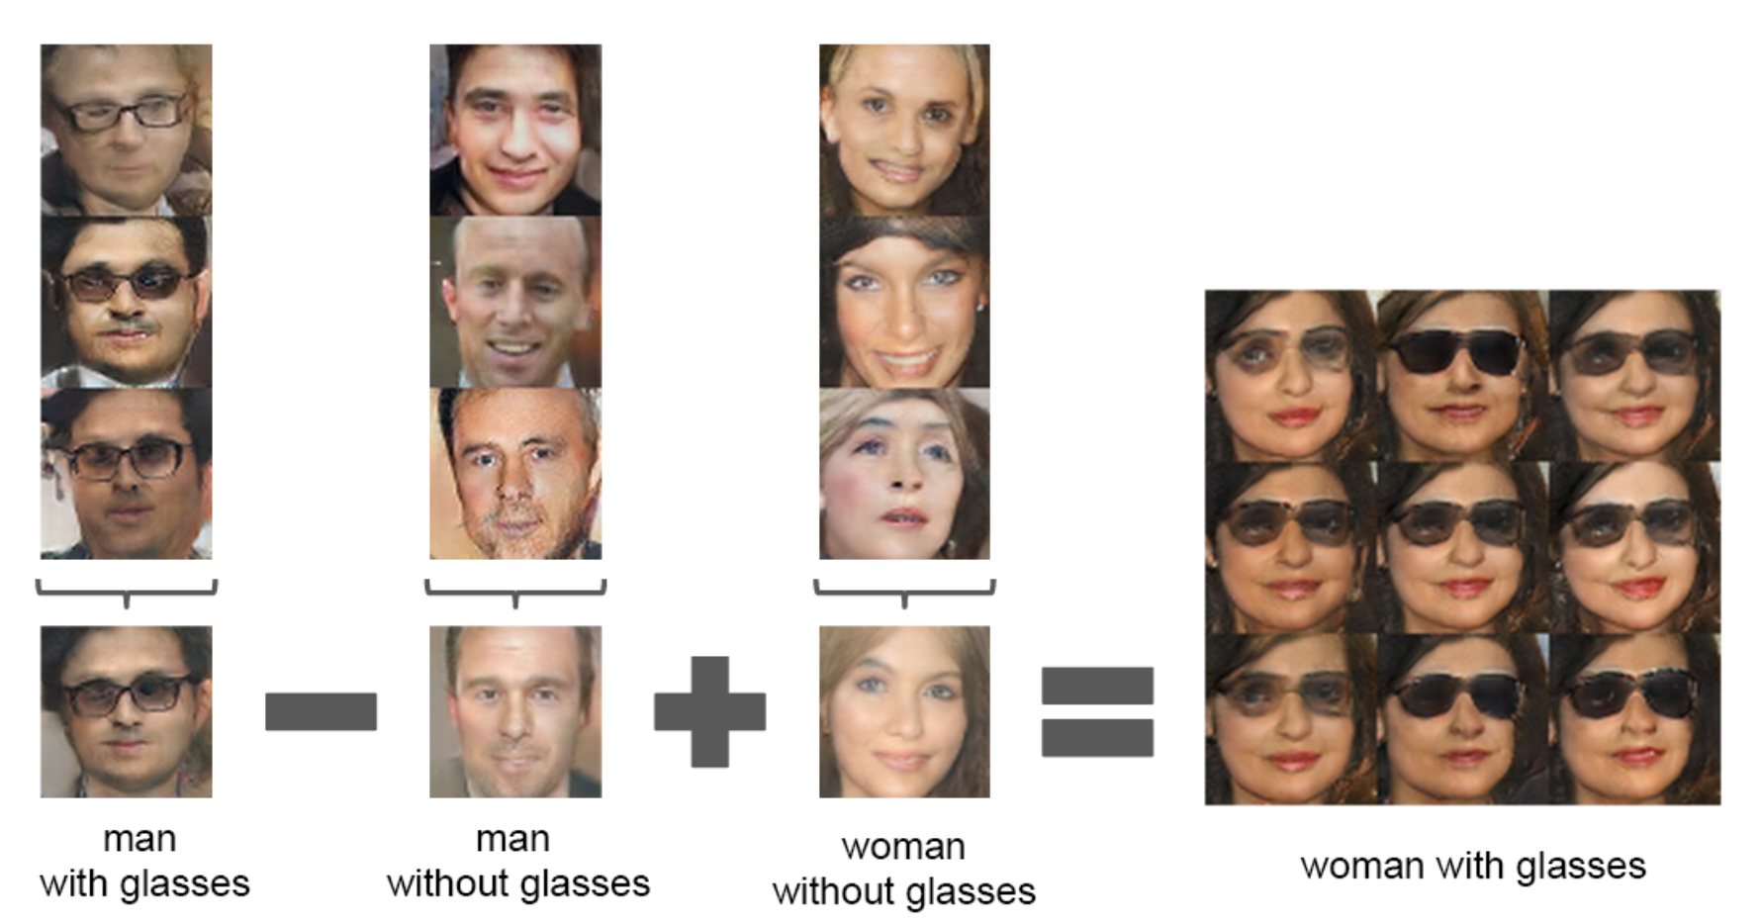
DCGAN
・Vector arithmetic for visual concepts
(Radford et al, ICLR 2016)

Slide 27


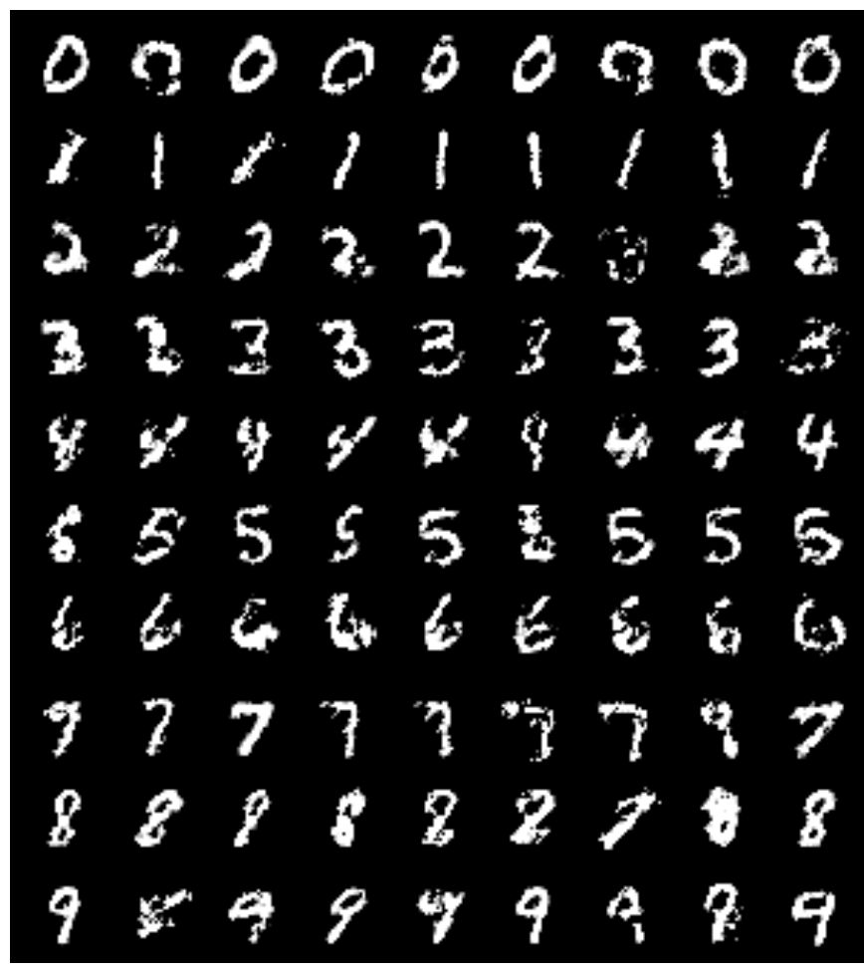

Conditional GAN
(Mirza et al, 2014)
Class labels are encoded as one-hot vectors
Control class labels of images by feeding one-hot vectors to both Discriminator & Generator
Conditions on
the instances for both D & G

Slide 28
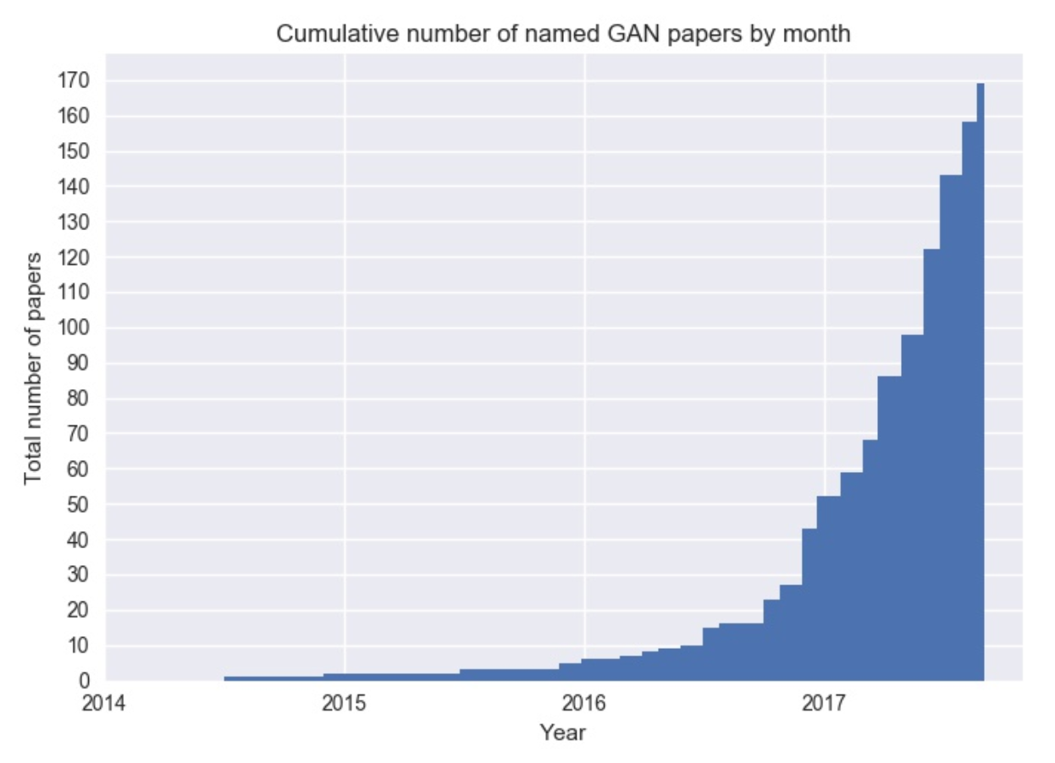
GAN Zoo
Near to 200 GAN variants since the vanilla GAN was proposed in 2014
The GAN Zoo:
https://deephunt.in/the-gan-zoo-79597dc8c347

Slide 29
Questions
Is there anyway to evaluate the
generated images automatically?
(so hard with training <-> looking)

Slide 30
Applications of Generative Models

Slide 31
Applications of Generative Models
Create art works
Build simulation environments
Fix corrupted data…

Slide 32
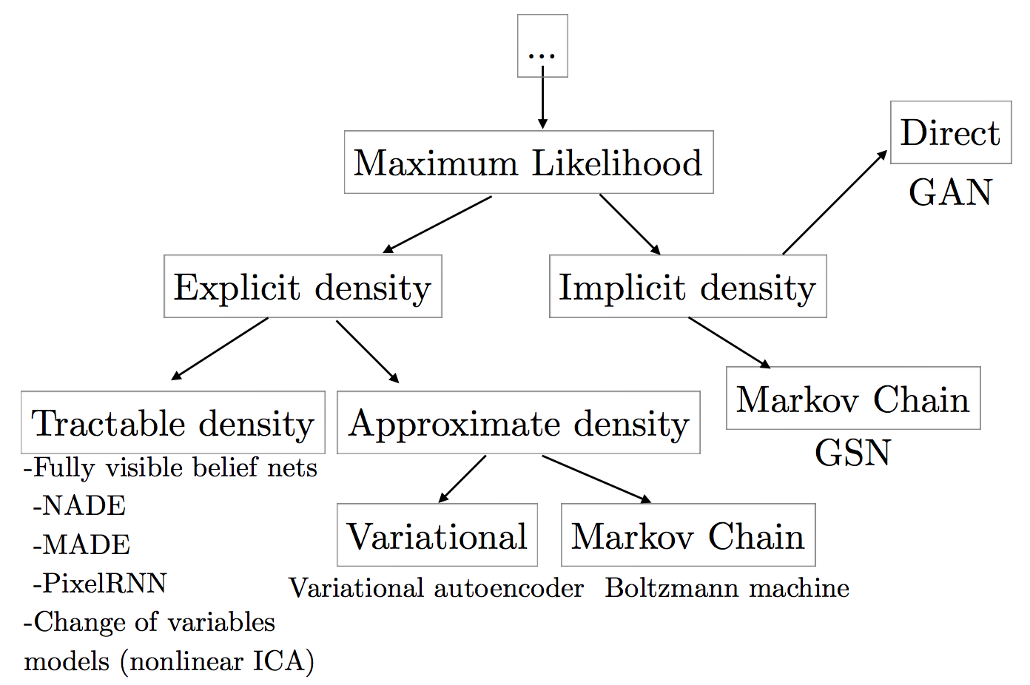
Generative Modeling methods
(Goodfellow 2016)

Slide 33
Summary
GAN trains a generator along with a discriminator by an adversarial process:
Discriminator aims to differentiate between real data and generated data
Generator tries to fool the discriminator by generating data
Both of discriminator and generator are usually neural networks (although they can be other models)
Proposed in 2014, GAN opened a new and hot research trend in Generative Modeling

Slide 34

Thank you!

